Slide 1
DATABASE DESIGN AND IMPLEMENTATION
Redundancy, integrity, completeness

Slide 2
Outline
Introduction and system Requirements
Entity sets, Attribute, and Relationship Identification
Conceptual Design with ER-Diagram
Physical Design(Collections)
Index Design and Optimization.
Implementation

Slide 3
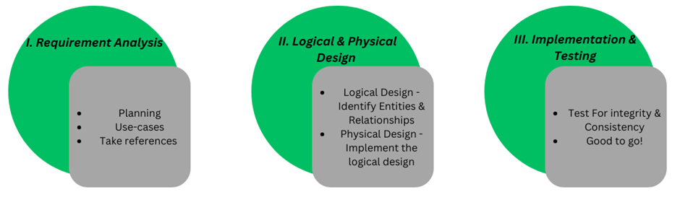
INTRODUCTION
Why design?
Design method used

Slide 4
SYSTEM REQUIREMENTS
User Management
Matching and Search
Notification System:
Support System
Tracking System
Email System

Slide 5
Entity Set, Attributes, and Relationships Identification
Entity Set Identification: Nouns and Nouns Phrases.
users, items, notifications
Attributes Identification: important properties of Entities
User may have properties like, name, email, password
Relationship Identification: How entities interact with each other
User Search An item

Slide 6
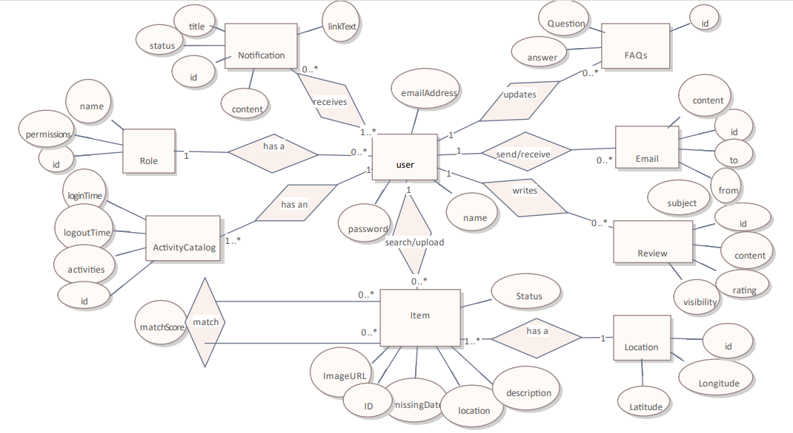
CONCEPTUAL DESING USING ER DIAGRAM

Slide 7
Physical Design
Tailored to MongoDB
we will translate the entities, attributes, and relationships identified in our Entity-Relationship (ER) diagram into collections and documents
Each entity from the ER diagram will correspond to a collection, and the attributes of these entities will be represented as fields within these documents.
Relationships will be managed using embedded documents and references.

Slide 8
Physical Design
users
{
"_id": ObjectId,
"password": String,
"name": String,
"email": String,
"role": {
"roleId": ObjectId,
"roleName": String,
"permissions": [String]
},
"activityLog": [
{
"activityId": ObjectId,
"loginTime": Date,
"logoutTime": Date,
"activities": String
}
]
}

Slide 9
INDEX DESIGN AND OPTIMIZATION
What is Indexing?
Without indexes, a database must scan every document or record to find those that match a query, which can be slow and inefficient, especially with large datasets.
How Indexing Works?
Indexes work similarly to the index in a book, which helps you quickly locate information without having to read every page.

Slide 10
Collection: matches Indexing
Index on LostItemId and FoundItemId
Reason: Efficient retrieval of related lost and found items.
Index on Status
Reason: Facilitates filtering based on match status.

Slide 11
DATABASE IMPLEMENTATION.
MongoDB Atlas
Login
Create Cluster
Create Database
Create Collections
Create indexes

Slide 12
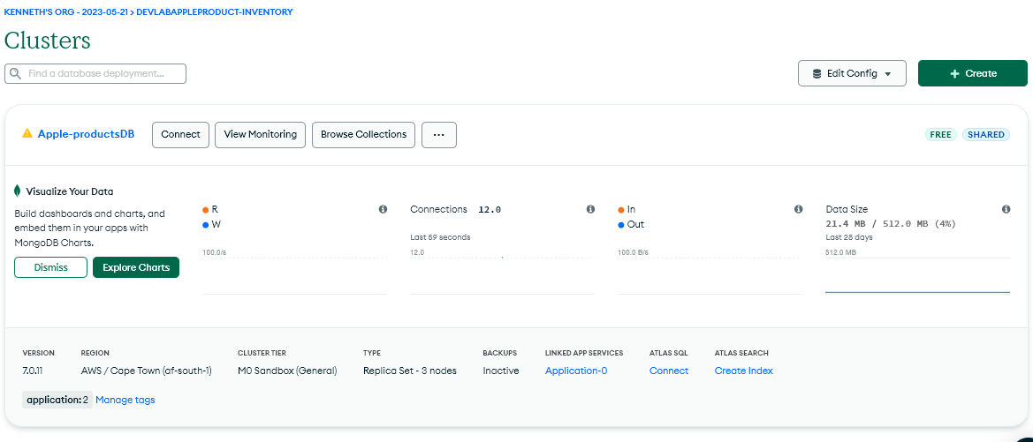
Create Cluster

Slide 13
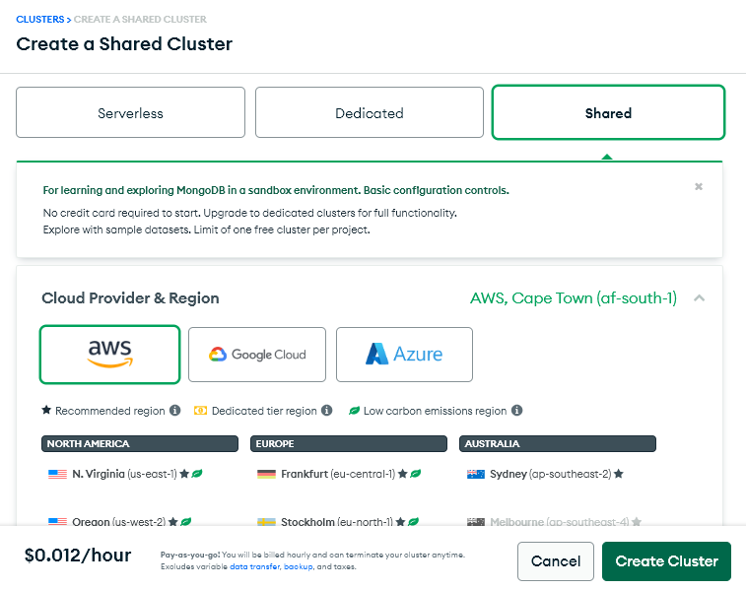
Select Cloud Provider and Region.

Slide 14
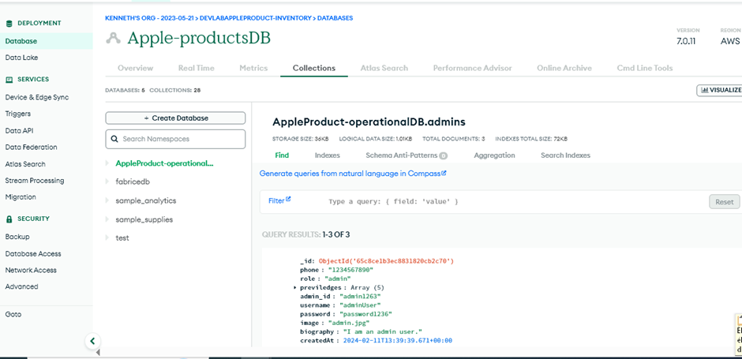
Create Database

Slide 15
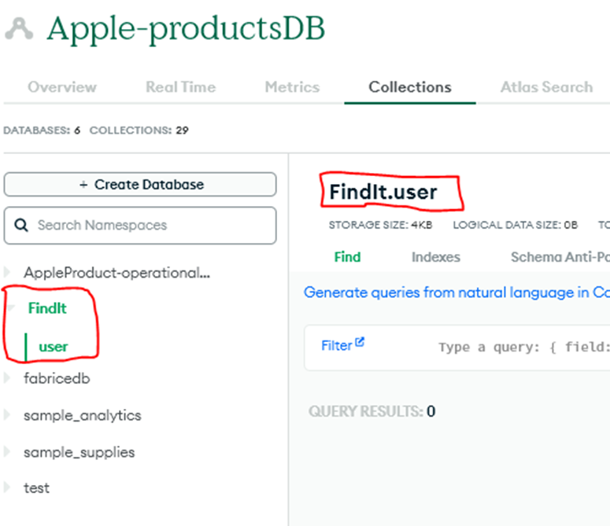
Result Database Creation

Slide 16
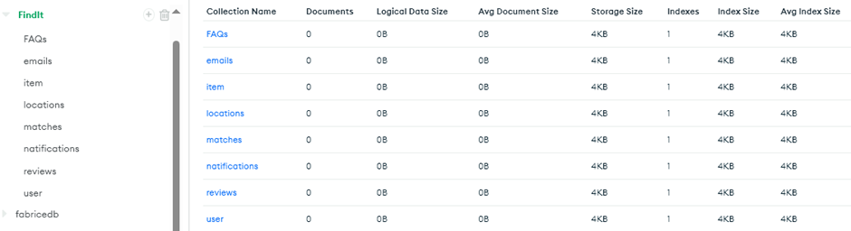
All Collections Created

Slide 17
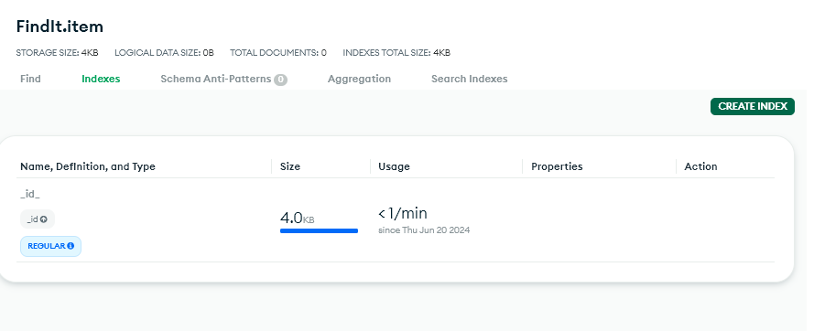
Creating Indexes

Slide 18
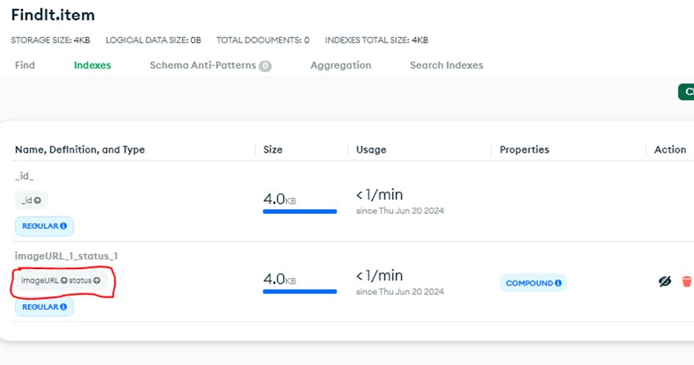
Created item indexes

Slide 19
Conclusion
Thanks For you Kind Attension

